Slide 1

PROBLEM DOMAIN
Control of forest fire
Implementation of Hydraulic system to reduce loss of lives during forest fire.

Slide 2

THE TRIPLE F
Fire Free Forest
An initiative to upgrade the control system for forest fire in our country efficiently, at low cost and easy installation

Slide 3


Contents
05/
Implementation
and
Prototype
03/
Abstract
01/
Problem Recognition
04/
Components Required
06/
Conclusion
02/
Problem Statement

Slide 4
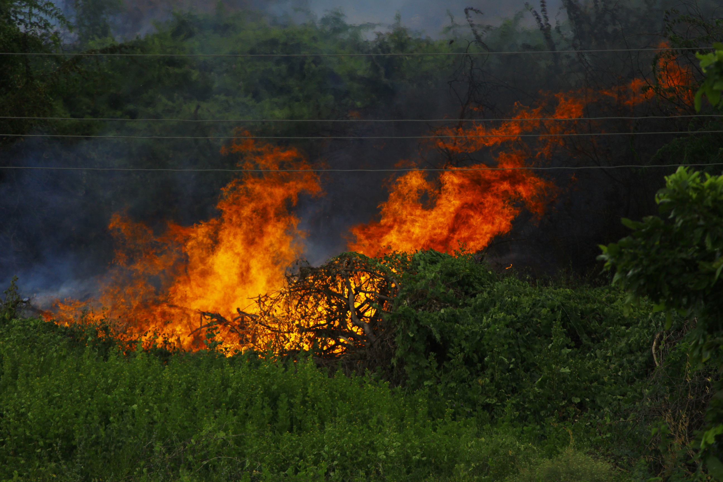
01/
Problem Recognition
A forest fire, also known as a wildfire or bushfire, is an uncontrolled fire that spreads rapidly through vegetation in forests, grasslands, or other wild areas. These fires can
have devastating ecological, economic, and human impacts.
Causes: Forest fires can be ignited by various factors, including lightning strikes, human activities (such as campfires, discarded cigarettes, or arson), and even volcanic eruptions.
Spread: They spread quickly due to the abundance of fuel in the form of dry leaves, branches, and trees. Wind can also play a significant role in their rapid
expansion.
Ecological Impact: Forest fires are a natural part of many ecosystems and can have ecological benefits, such as clearing dead vegetation and promoting new growth. However, frequent or extremely intense fires can disrupt ecosystems and harm wildlife.

Slide 5
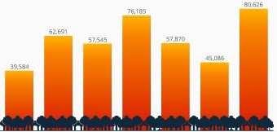
02/
Problem Statement
Increased occurance of forest fires due to Global Warming and other factors leads to major loss of Wildlife and Vegetation.
To control this needy situation, proper measures have to be taken in a readily standard by initiating this petty idea.
Record number of wildfires burning in the amazon
2013 2014 2015 2016 2017 2018 2019

Slide 6
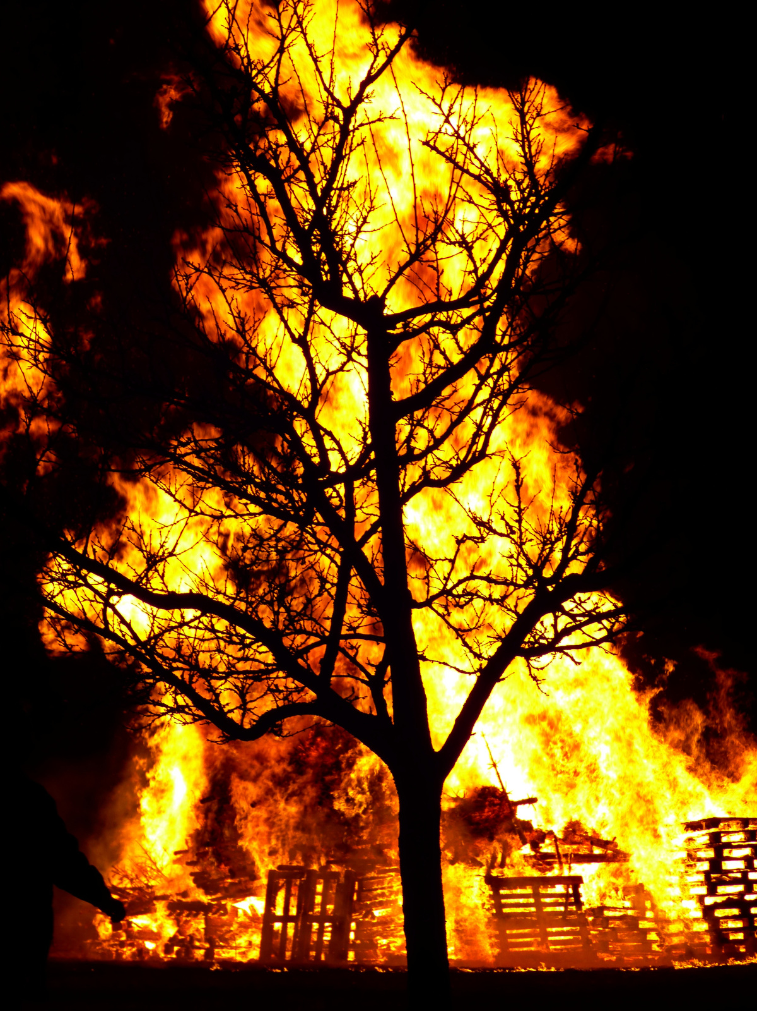
03/
Abstract
Forest fires have become a major threat around the world, causing many negative impacts on human habitats and forest ecosystems. Climatic changes and the greenhouse effect are some of the consequences of such destruction. Unfortunately, a higher percentage of forest fires occur due to human activities. Therefore, to minimize the destruction caused by forest fires, there is a need to detect forest fires at their initial stage. This paper proposes a system and methodology that can be used to detect forest fires. Our system deals with a easy and less expensive methadology that helps in controlling the huge losses that occur because of forest fire .

Slide 7

04/
Components Required
Arduino
Tubelight starter - metal
Battery
Water pump motor
Tube

Slide 8
05/
Implementation and prototype
A metal is generally regarded as any substance capable of conducting electricity at a temperature of absolute zero.
When heated, metal expands. Temperature causes an increase in length, surface area and thickness. Thermal expansion is the technical name for this.
The expansion or contraction of any material is due to the kinetic energy of its atoms. When a material is heated, the increase in energy causes the atoms and molecules to move more and to take up more space, that is to expand.
Heat causes metals to expand; cooling causes them to contract. Therefore, uneven heating causes uneven expansion, and uneven cooling causes uneven contraction.

Slide 9
Our device has a starter with two metal strips which has no contact among them, in which one of its metal is bent.When there is a chance of fire in the forest the heat and flame produced by it heats the starter and hence the metal strip inside undergoes Thermal expansion and causes the bent strip to form a connection with the other.
This forms a closed circuit between them and passes current from the battery through it and it correspondingly reguates the water pump motor which in turn stimulates the rain water storage tank.
This action leads the water pump motor to disperse the stored water throughout the possibly covered area and could control the amount of fire and minimize the loss of wildlife and vegetation in the forest.

Slide 10
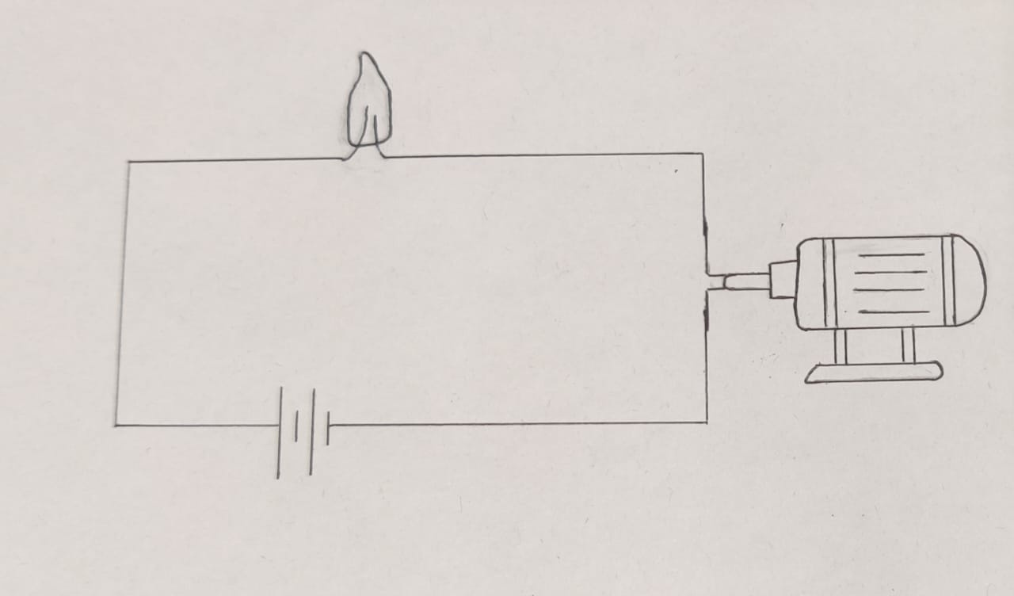
Circuit Diagram
Tubelight starter
Water pump motor
Battery

Slide 11
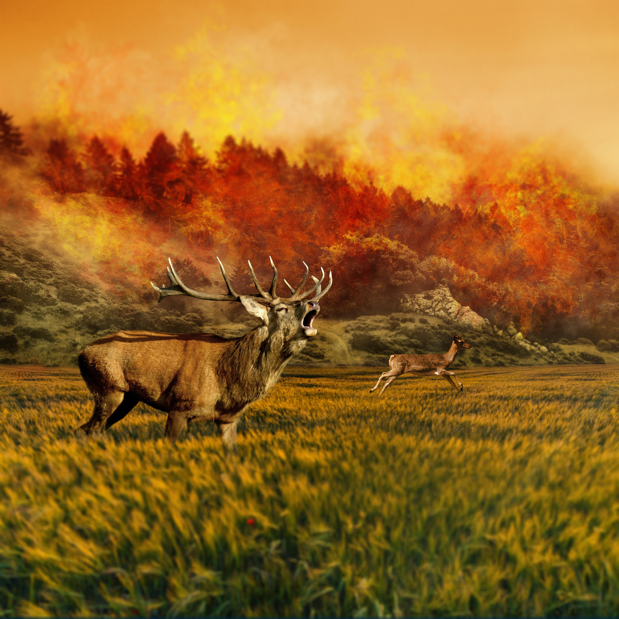
06/
Conclusions
The system proposed for forest fire control using Thermal Expansion gives more accurate outcome within the lowest latency, the analysis takes place between the metal expansion and rainwater storage system . For the system, to fit any weather condition, climatic condition, or area, a variety of metals that can undergo thermal expansion can be used . The proposed system can be incorporated with the communication infrastructure to alert the relevant
authorities .

Slide 12
